Slide 1


Grade 6
Guangren Elementary School
Special Edition Newsletter
Grade 6 Newsletter Week 10: October 28th - November 1st, 2024
光仁國小ESL雙語班週報 – 六年級
第一學期第十週 十月二十八日 – 十一月一日
Contents 目錄
A peak at our week 1. 一探究竟我們本週課程
Special Acknowledgement 2. 特別感謝
Birthdays of the month 3. 本月壽星

Slide 2

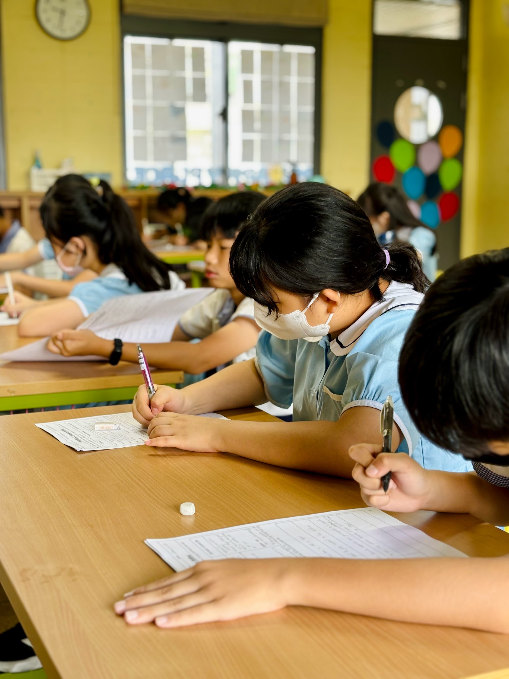
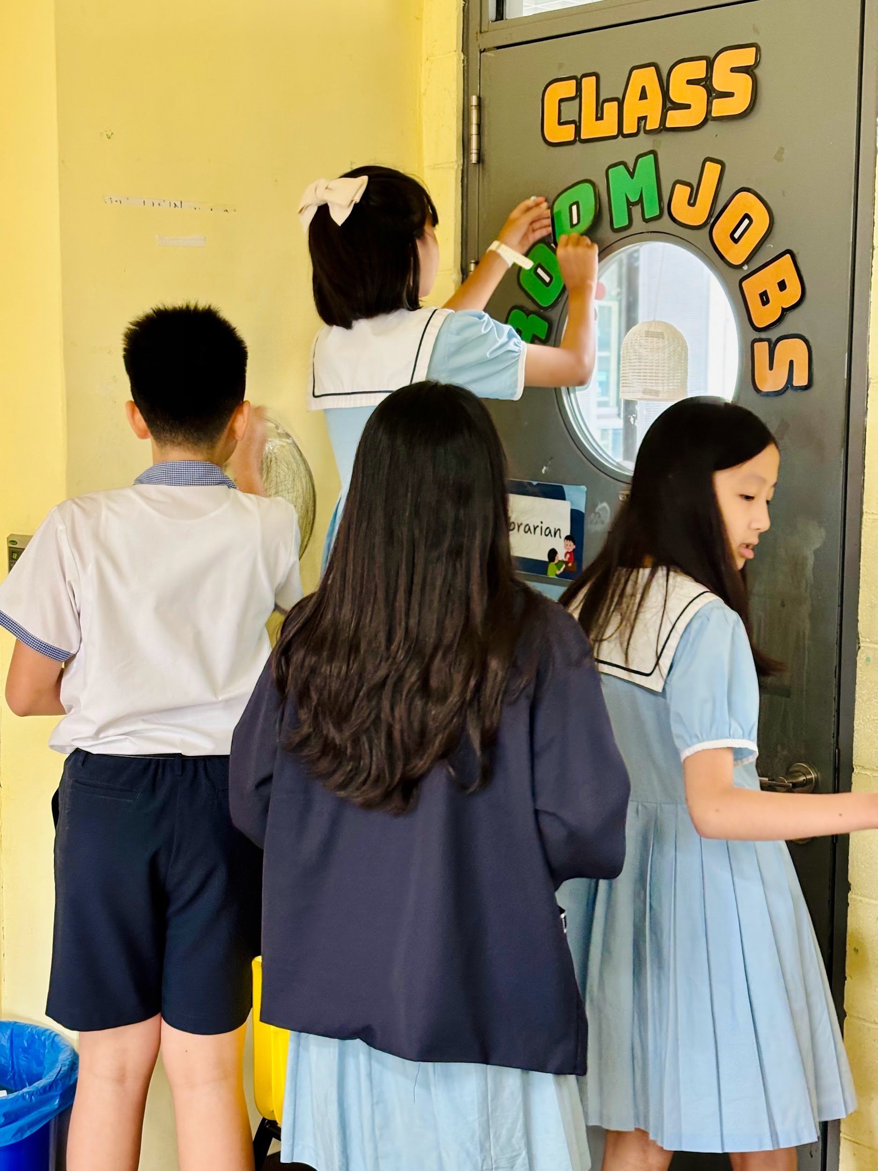
G6 Yellow: Ren and Ai
六年級黃組：仁班及愛班
In Ren6 yellow class, students finalized their CT biography writing. After drafting, revising, and editing, students were ready to publish their final draft. Students worked hard on this essay and the results showed this effort.
在六仁黃組的課堂上，學生們完成了單元總結的傳記寫作。經過草稿、修改和編輯後，學生準備好發表他們的完稿。學生在這篇論文寫作上付出了很大的心血，結果也應證了他們的努力。
In Ai6 Yellow class, students helped to contribute to the student community by decorating and organizing the real estate walls. Students worked together and collaborated on the activity to improve classroom cohesion.
在六愛黃組的課堂上，學生們透過裝飾和整理房地產牆，為學生社群盡一分力。在活動中，學生共同合作來提升班級的凝聚力。

Slide 3
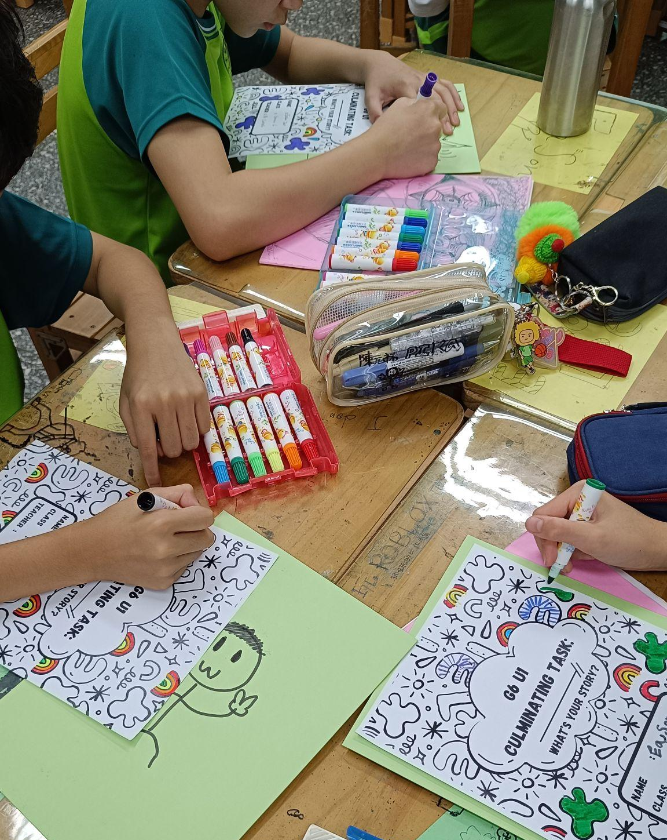
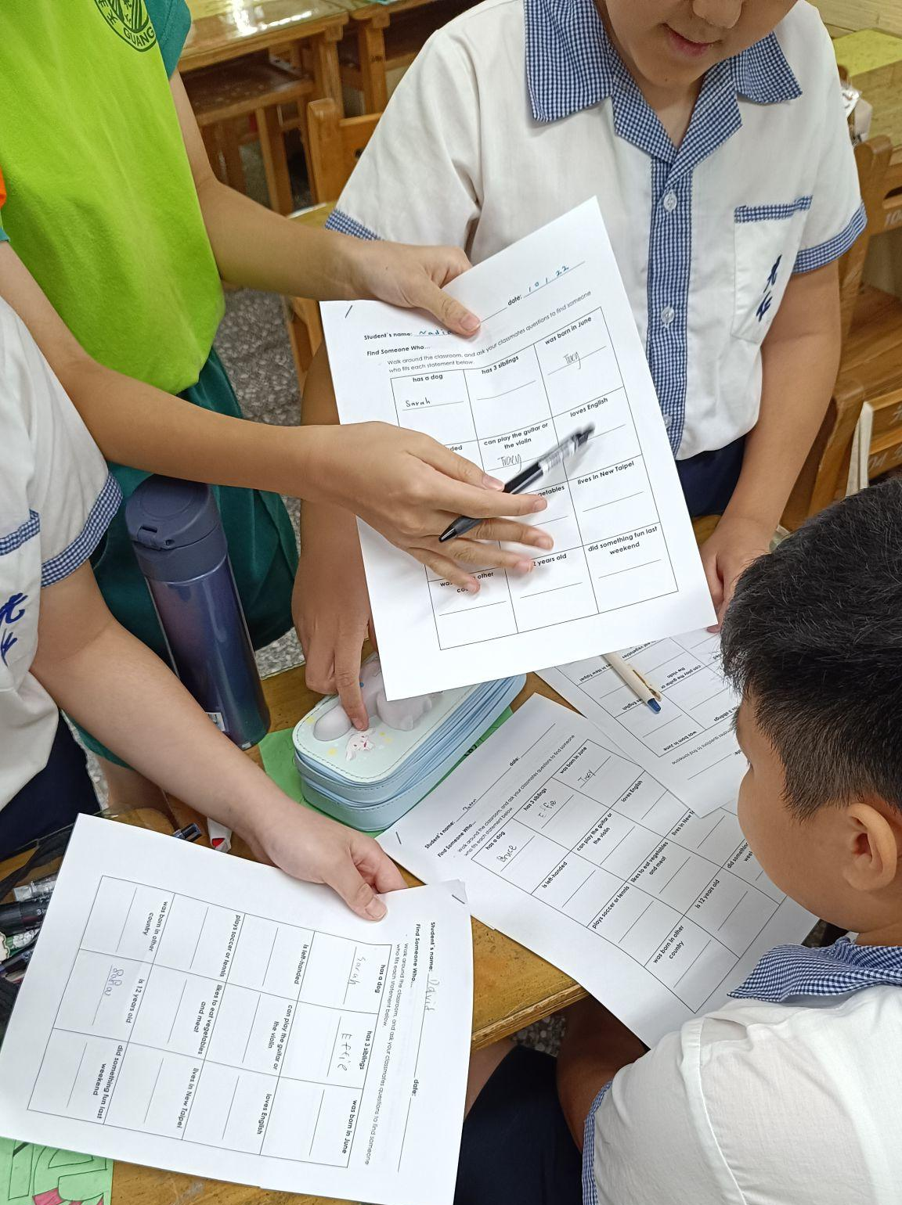

G6 Ren and Ai: Green
六年仁班及愛班：綠組
In G6 Ren and Ai green classes, after completing the application of the CT, the students decorated their folders for the small group centers and the cover of their written CT. They also participated in an oral activity where they asked their classmates questions to further practice forming questions and giving complete answers.
在六仁及六愛綠組的課堂上，學生們在完成應用單元總結後，學生以分組進行的方式來為他們的文件夾封面做了點綴和修飾。此外，他們還參予了口說的活動，藉由向同學提問，以進一步練習提出問題和給予完整的答案。

Slide 4
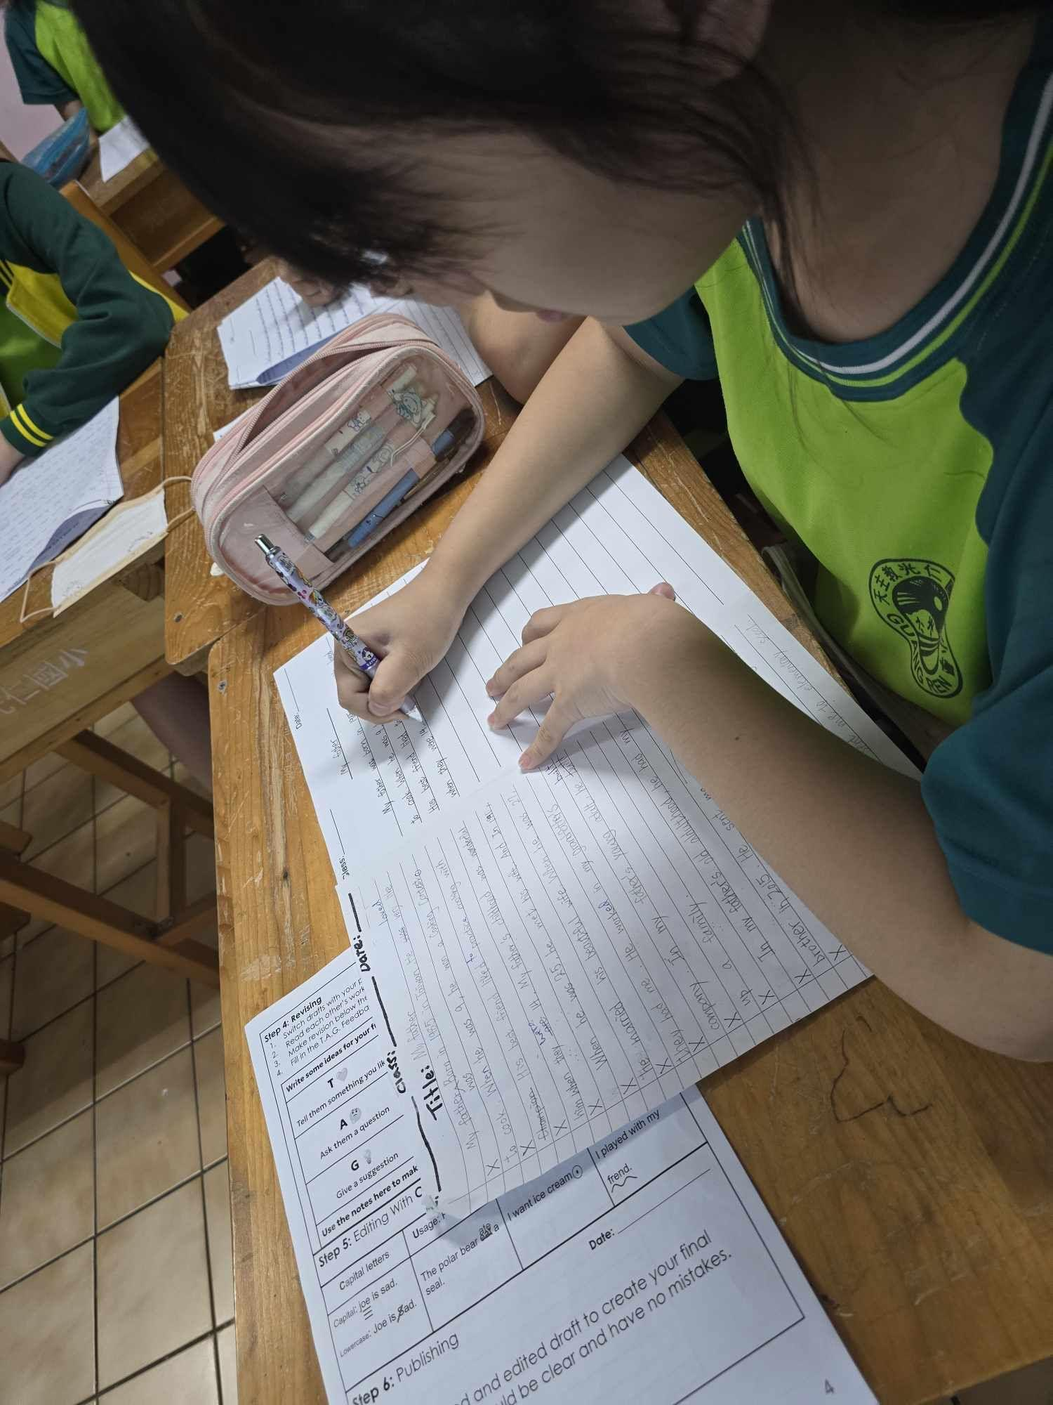
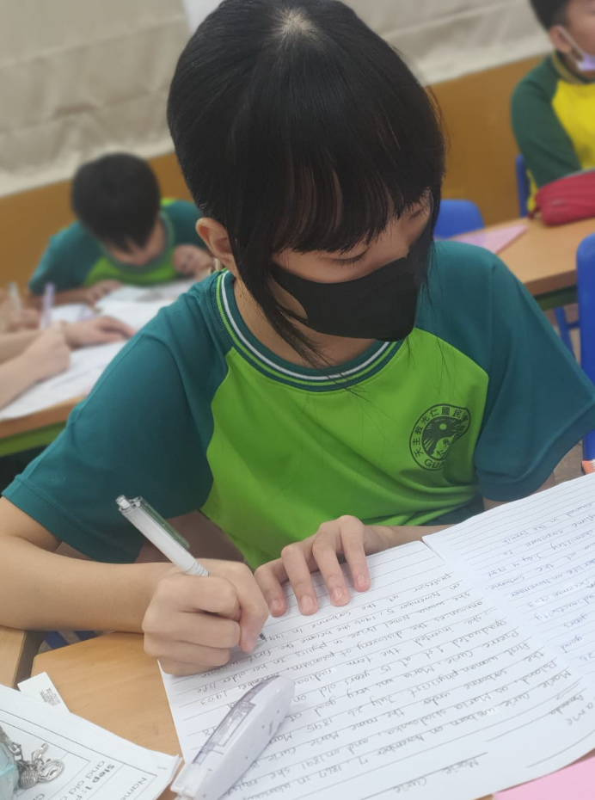

Xin 6 (Green and Yellow)
六年信班（綠組及黃組）
In Xin6 Green, students worked hard to complete their culminating project. Students practised their revising and editing skills to improve the draft of their essay to make it their best possible work.
在六信綠組的課堂上，學生們努地完成他們的單元總結。學生練習他們的修改和編輯技巧，以改善他們的論文草稿，使其成為最好的作品。
In Xin6 Yellow, students wrote their assessment CT and interviewed each other with follow up questions to sharpen their dialogue skills. This has been a key part of their progressive work in the past month.
在六信黃組的課堂上，學生們撰寫評量單元總結，並以延伸性問題做採訪來加強他們的對話技巧。這是他們過去一個月來不斷努力學習的單元重要內容。

Slide 5
Special Acknowledgments
特 別 感 謝
Throughout the month of October, students have become more engaged in class, participating in discussions and activities, speaking more English, and sharing their ideas. We would like to recognize these students for their initiative in class this month.
Ren 6: Yellow
六仁：
黃組
Sofia
Ai 6:
Yellow
六愛：
黃組
Melody
Patty
Raymond
Xin 6
Yellow
六信：
黃組
Janice
Dora
Ren 6:
Green
六仁：
綠組
Bruce
Effie
Ai 6:
Green
六愛：
綠組
Mars
Athena
Xin 6
Green
六信：
綠組
Abby
Francis

Slide 6

We would like to wish a happy birthday in October to:
我們祝福以下十月份的壽星，生日快樂!
Ren 6
六仁
Andrew
Elvis
Ai 6
六愛
Ellis
Eva
Cody
Kent
Xin 6
六信
Louis
Ben
Francis
Lily

