Slide 1


Guangren Elementary School
Grade 4
Special newsletter
Grade 4 Newsletter Week 10: October 28th - November 1st , 2024
光仁國小ESL雙語班週報 特別版 – 四年級
第一學期第十週 十月二十八日 – 十一月ㄧ日
Contents目錄
A Peek into Our Week! 1. 本週搶先看
Special Acknowledgements 2. 特別致謝
Birthdays of the month 3. 本月壽星
Shout Outs 4. 表揚時間

Slide 2
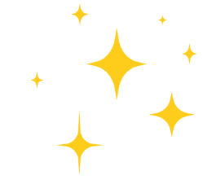

Grade 4 Yellow (Ai & Ren) class
四年級(愛&仁)班黃組
In yellow class, students can be seen participating in the daily ‘Invention of the day’, where we choose an invention and talk about life before and after the invention. Students also learned about the conjunction ‘although’ and did an activity where they had to match clauses together to complete the sentence.
在黃組中，可以看到學生們參與每天的「每日發明」，我們選擇一項發明，並談論發明之前和之後的生活。此外，學生還學習了連接詞 「although 雖然」，並進行了一項活動，讓他們將分句搭配在一起來完成句子。

Slide 3

Grade 4 Green (Ai & Ren) class
四年級(愛&仁)班 綠組
This week, Green Class got experimental! As part of learning about ‘Simple Machines’, we ran some experiments on inclined planes and wheels. We have also been reading ‘Three Little Pigs’, and will continue to do so next week!
本週，綠組進行了實驗！作為學習 「簡單機械 」的一部分，我們做了一些斜面和輪子的實驗。我們還閱讀了《三隻小豬》的故事，下週將會繼續閱讀！
Notes:
https://drive.google.com/file/d/1xwS6bu876dznuXeOGTby-Djh6IjFX1v2/view?usp=drive_link

Slide 4
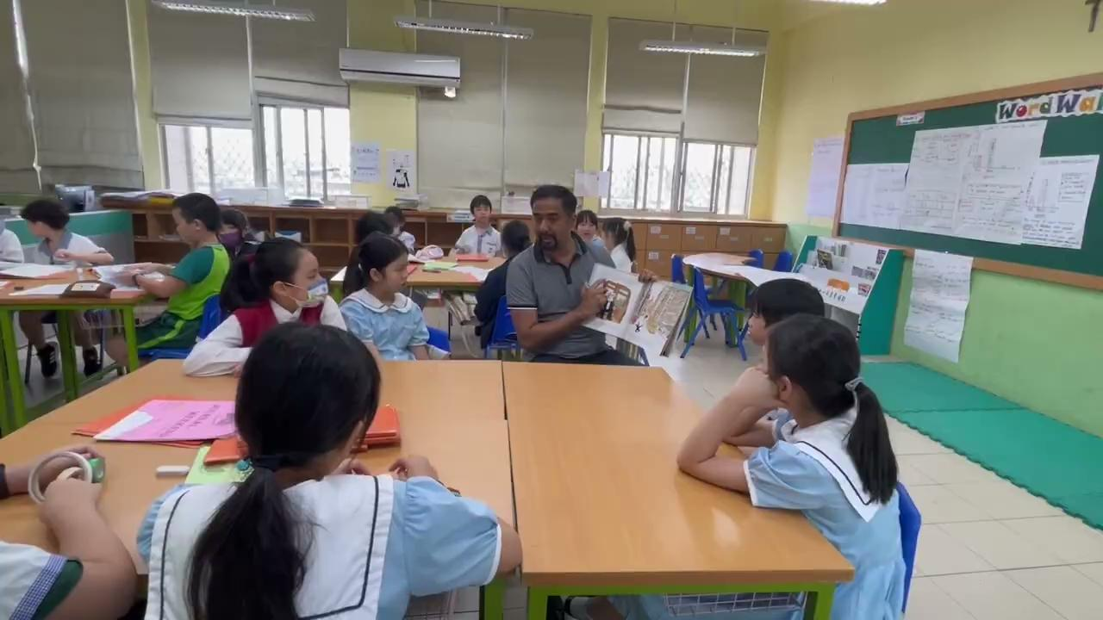
Grade 4 Yellow (Xin) class
四年級信班黃組
During the read-aloud of Just LIke Rube Goldberg, students listened closely to the true creative story, As they followed along, students were curious about the imaginative inventions, asking questions and eagerly discussing the life and creativity of Rube Goldberg.
在朗讀《Just Like Rube Goldberg》時，學生們仔細聆聽真實的創意故事，並對於充滿想像力的發明感到好奇，並踴躍發問和討論 Rube Goldberg 的生平和創意。

Slide 5

Special
Acknowledgements:
特別感謝:
We want to give a special shout-out to our amazing grade 4 students for continuously trying their best in being responsible, independent, initiative and collaborative in their classrooms.Keep it up!
我們要特別感謝我們出色的四年級學生，他們在課堂上不斷地盡力做到負責、獨立、主動和互相合作！請保持下去!
GREEN CLASS
Angela - For their amazing homework!
Jamie - For his outstanding effort!
Charlotte & Peggy - For their great work with Mr G!
綠組
Angela - 表揚他們出色的家庭作業！
Jamie - 表揚他的傑出努力！
Charlotte 和 Peggy - 表揚他們與 G 先生一起完成的出色作業！

Slide 6

To all the wonderful people celebrating in October—we hope your month was filled with joy and special moments! 🎉🎂
祝福所有在十月生日的學生們--願您的月份充滿歡樂和特別的時刻！🎉🎂
Ai Class 愛班
Aston
Nana
Ken
Alan
Molly
Ren Class 仁班
Jill
Jordan
Xin Class 信班
No birthdays
無人生日
🎂
🎉

Slide 7

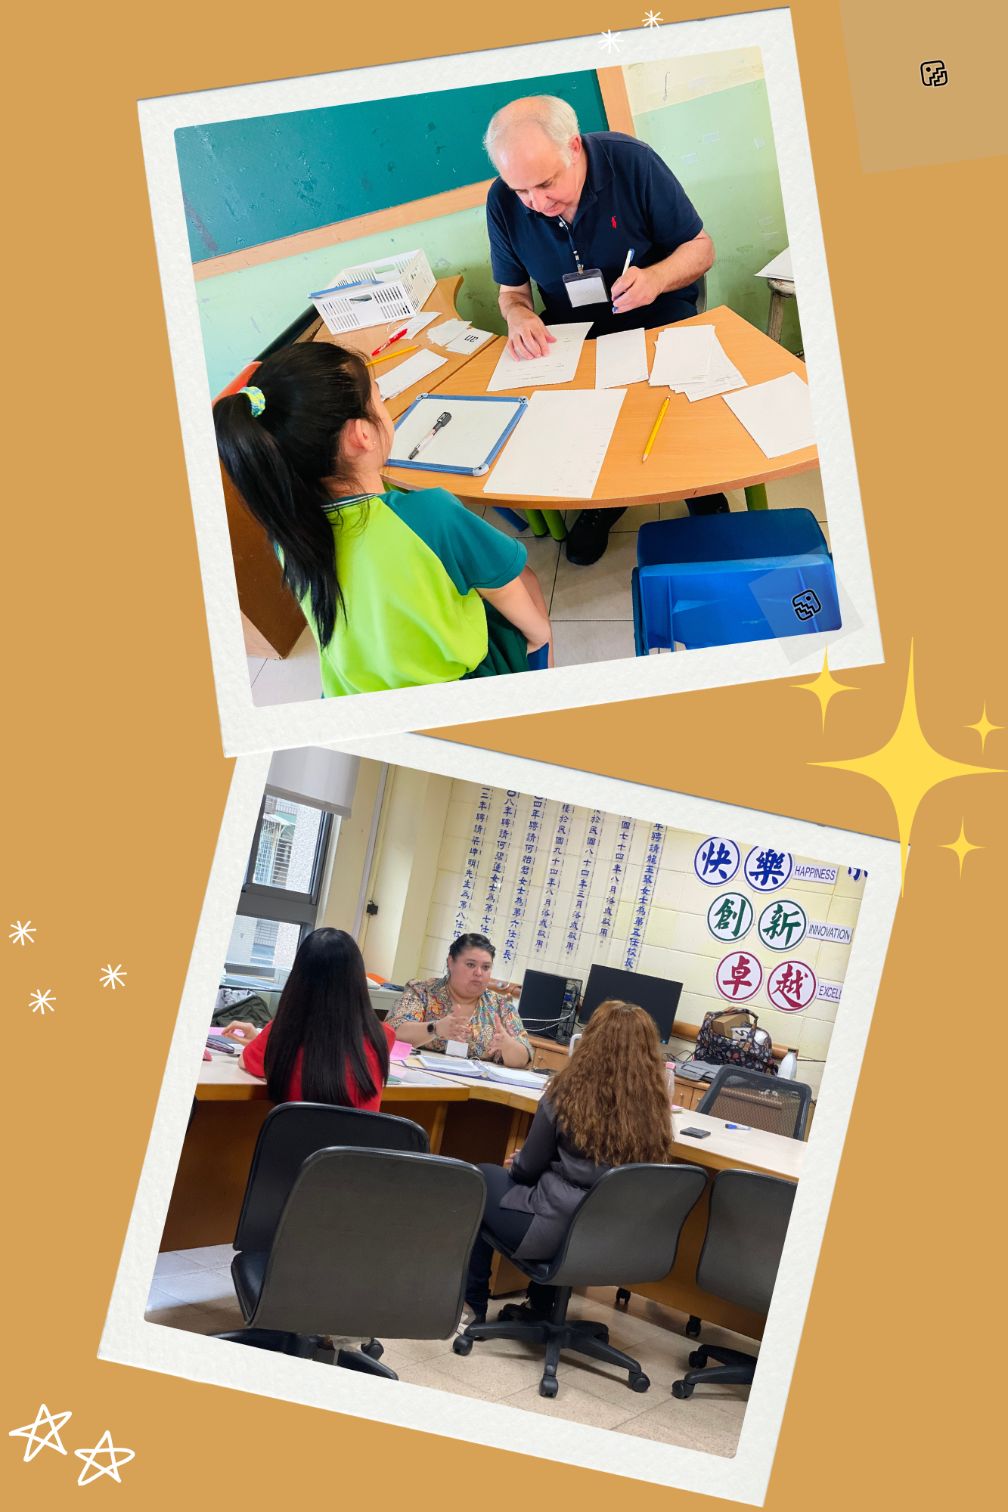
ShoutOuts:
表揚時間
🎉 A huge THANK YOU to our amazing support teachers for your dedication and hard work! Your efforts in helping both teachers and students make a tremendous difference in our learning environment. You rock! 🌟
衷心感謝我們出色的支援教師，感謝他們的奉獻和辛苦工作！你們在幫助老師和學生方面所做的努力為我們的學習環境帶來了巨大的變化。你們是最棒的！🌟

